Slide 1

Student Application
Uganda Baptist Seminary
"Preach the Word" — II Timothy 4:2

Slide 2



1. COURSE SELECTION
Please tick the level of study for your application:
Certificate
Diploma
Bachelor
Foundational Biblical knowledge for ministry.
Pastoral and practical leadership training.
In-depth theological and academic research.

Slide 3
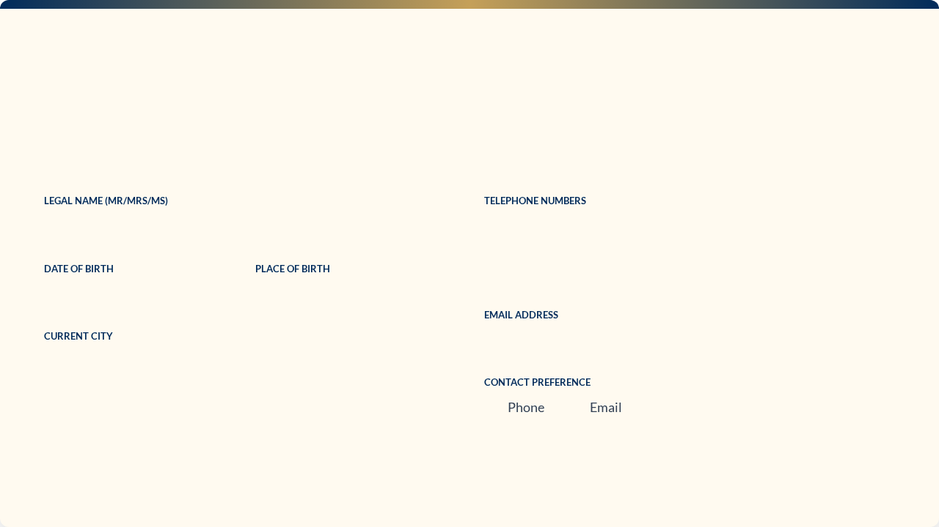


2. PERSONAL INFORMATION

Slide 4
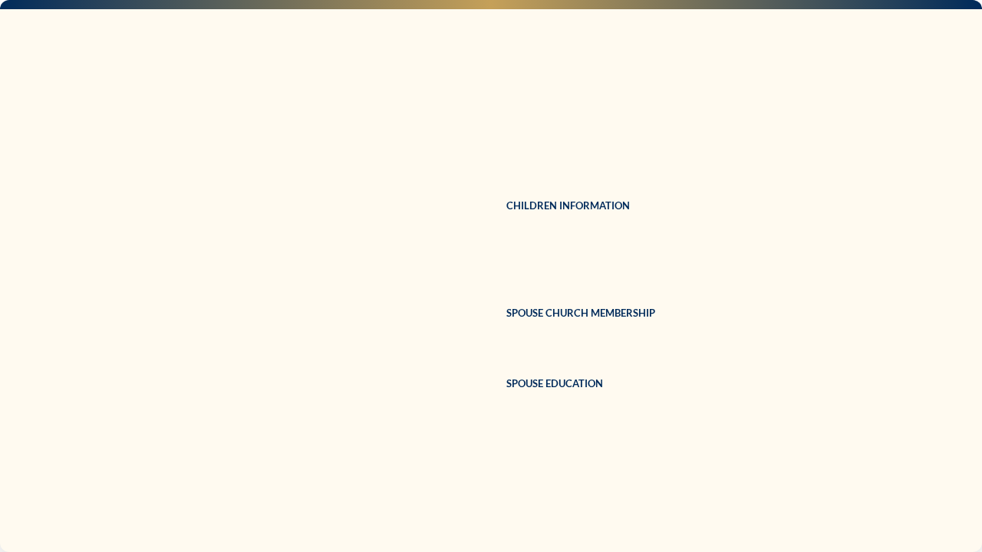
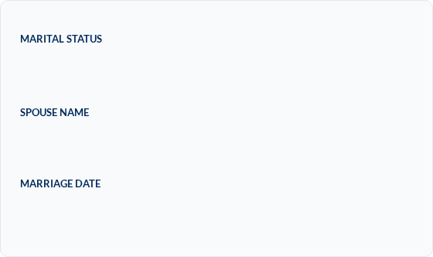
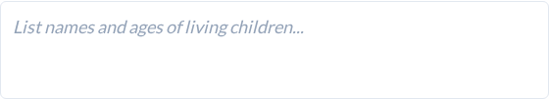


3. FAMILY INFORMATION
Married Single Widow(er) Divorced

Slide 5



4. EDUCATION: SCHOOLING

Slide 6
5. HIGHER EDUCATION
List institutions attended and awards gained (Certified copies required):
Institution Name | Course Studied | Qualification Gained
[University/College] | [Degree Course] | [Certificate/Diploma]
[University/College] | [Degree Course] | [Certificate/Diploma]
[University/College] | [Degree Course] | [Certificate/Diploma]

Slide 7
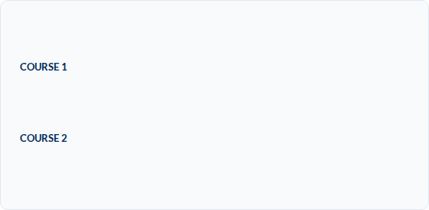





6. BIBLE SCHOOLS & COURSES
Nationally Recognized
Local Bible Schools

Slide 8



7. WORK EXPERIENCE
Employer Permission
Will your employer allow you to attend classes at UBS?

Slide 9


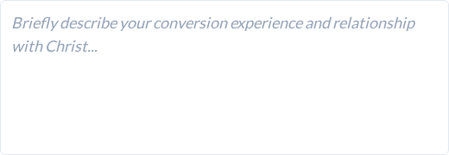
8. CHRISTIAN EXPERIENCE

Slide 10
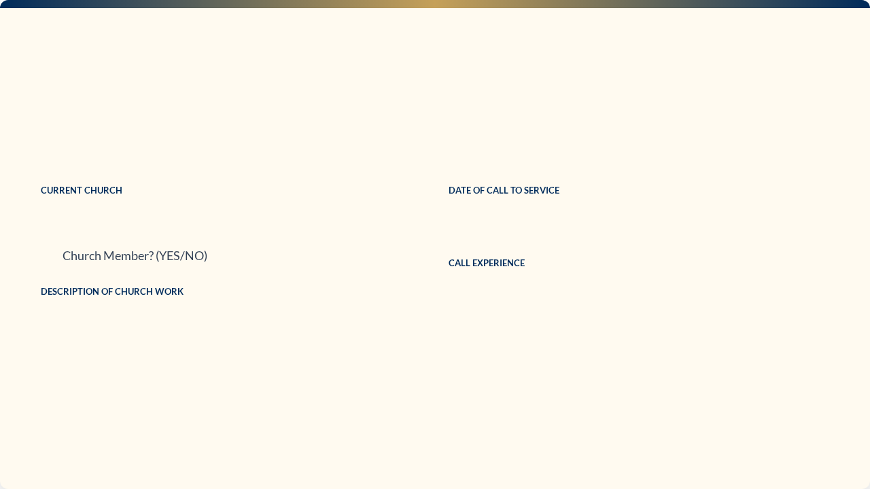
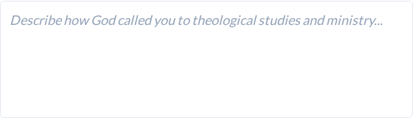
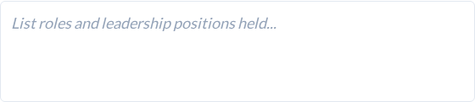
MINISTRY & CALL

Slide 11
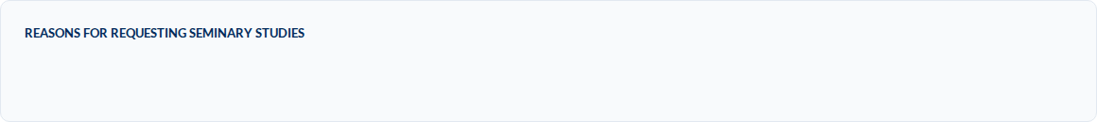
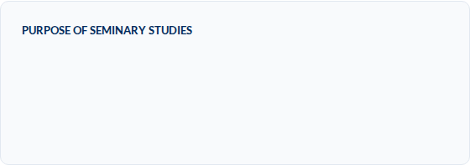
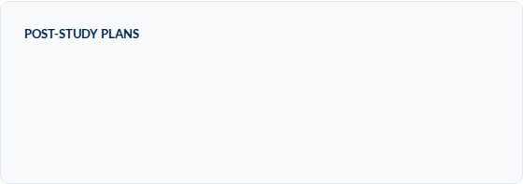
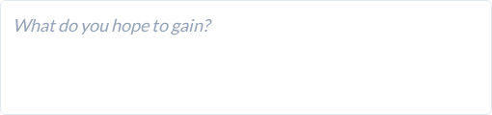
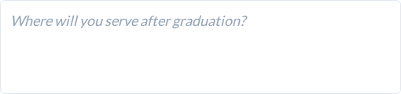
9. ADDITIONAL INFORMATION

Slide 12



10. FINANCES
Payment Plan (UGX per term):
Bursary Adjusted Rates
Level | Baptist | Non-Baptist
Bachelors | 460,000 | 510,000
Diploma | 310,000 | 360,000
Certificate | 310,000 | 360,000
*Letters of support are required from Church/Association sponsors.
Actual cost is UGX 1,000,000; rates reflect internal bursary subsidies.

Slide 13
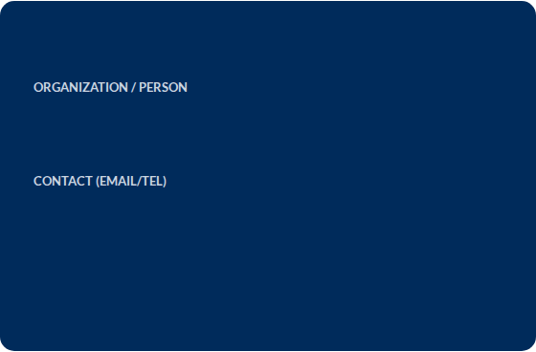



11. SPONSOR SUPPORT
Sponsor Details
UBS will verify sponsor information. Inaccurate details are grounds for immediate dismissal.

Slide 14

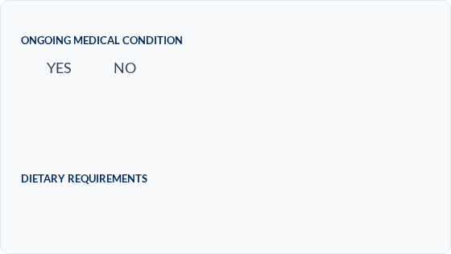




12. HEALTH INFORMATION
Medical Acknowledgement
UBS does not provide medical care or special diets. These remain the sole responsibility of the student. By signing, you confirm personal provision for these needs.

Slide 15
13. REFERENCES
Provide contact details for your three chosen references (Pastor, Employer, Graduate, etc.):
Reference Name | Position / Relationship | Email / Telephone
[Ref 1] | [Pastor/Employer] | [Contact Details]
[Ref 2] | [Seminary Graduate/Missionary] | [Contact Details]
[Ref 3] | [Christian Friend/Leader] | [Contact Details]
Reference letters must be collected and uploaded with this application.

Slide 16


14. VERIFICATION CHECKLIST
Passport Size Photograph
Certified Certificates & Transcripts
Three Letters of Reference
Sponsor Support Letters
Applications will only be processed after ALL documents are received.

Slide 17

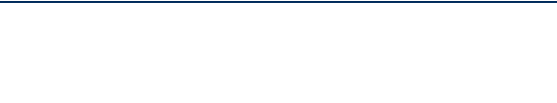
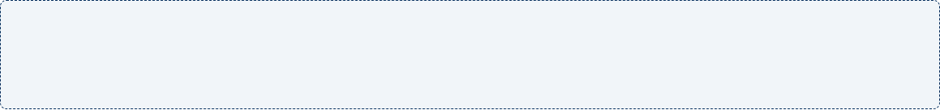

15. FINAL DECLARATION
"I declare that the information given on this application is accurate and complete. I understand that my application will not be processed until all verification items are received."
APPLICANT SIGNATURE
DATE
Submission Destination Info:
Upon submission, a PDF copy of your form and all attached files will be securely emailed to: b.masaba@ugandabaptistseminary.org, b.masaba256@gmail.com, and musicvoicechat@gmail.com

Slide 18




IMAGE SOURCES
x-raw-image:///0e9c7720e0a6782e25e1a3cc02b414d2ddb48c29f669a40404937356ea892e19
Source: ugandabaptistseminary.org
http://thedailygraceco.com/cdn/shop/articles/8_677430b7-f504-426c-9f9c-3bf6182ea91b.png?v=1775488012
Source: thedailygraceco.com
https://images.squarespace-cdn.com/content/v1/635bff73434dcc204d676862/57abaf40-27d2-421a-ba14-d7d59534f765/IMG-20180228-WA0015.jpg
Source: www.newwineskins.org
https://ugandabaptistseminary.org/wp-content/uploads/2022/08/cropped-ubs-exterior-2-e1674867889682.jpeg
Source: ugandabaptistseminary.org

